Slide 1


Computational and Theoretical Study of Disordered Systems
Xiang Cheng
Department of Physics, Emory University
PhD Dissertation Defense
09/23/2016
Supported by the NSF through Grant No. DMR-1207431
Notes:
Thanks for coming.
Generally, better explanations; more to-the-point;

Slide 2
Outline
Introduction of Disordered Systems
Jamming in Hierarchical Networks (HNs)
Antiferromagnetic Ising model in HNs
Aging in Random Field Ising Model
Summary
Notes:
Today, I will first generally introduce disordered systems; then I will explain 3 projects on 3 specific disordered systems; in the end, it is the summary and conclusion.

Slide 3
Introduction
Disordered material is the majority
Numerous categories:
Glass, polymer, granular materials, biological tissues, etc.
More unclear questions
Focus on theoretical models
Lattice glass model
Antiferromagnetic Ising model
Random Field Ising model
Notes:
Add pictures;
Most materials in the world may be classified as ordered and disordered materials. For example, crystal is an ordered material, and glass is disordered materials. Usually, there is only one possibility for an ordered material; but disordered material could have infinite possibility. So disorderd material is majority; however it is less studied and there are more questions that are unclear. And these questions

Slide 4
Outline
Introduction of Disordered Systems
Jamming in Hierarchical Networks (HNs)
Antiferromagnetic Ising model in HNs
Aging in Random Field Ising Model
Summary

Slide 5
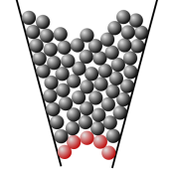

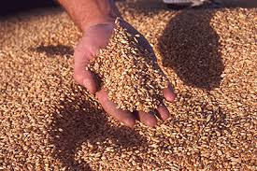
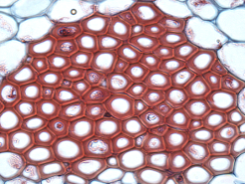
Jamming transition
Jammed states are common.
Characteristics
High packing density (not highest)
Out of equilibrium
Extremely slow relaxation
A challenge to understand
What causes the extremely slow relaxation?
Equilibrium state?
Equilibrium phase transition?
Zhang, .et al and Liu, Nature 459, 230 (2009)

Slide 6
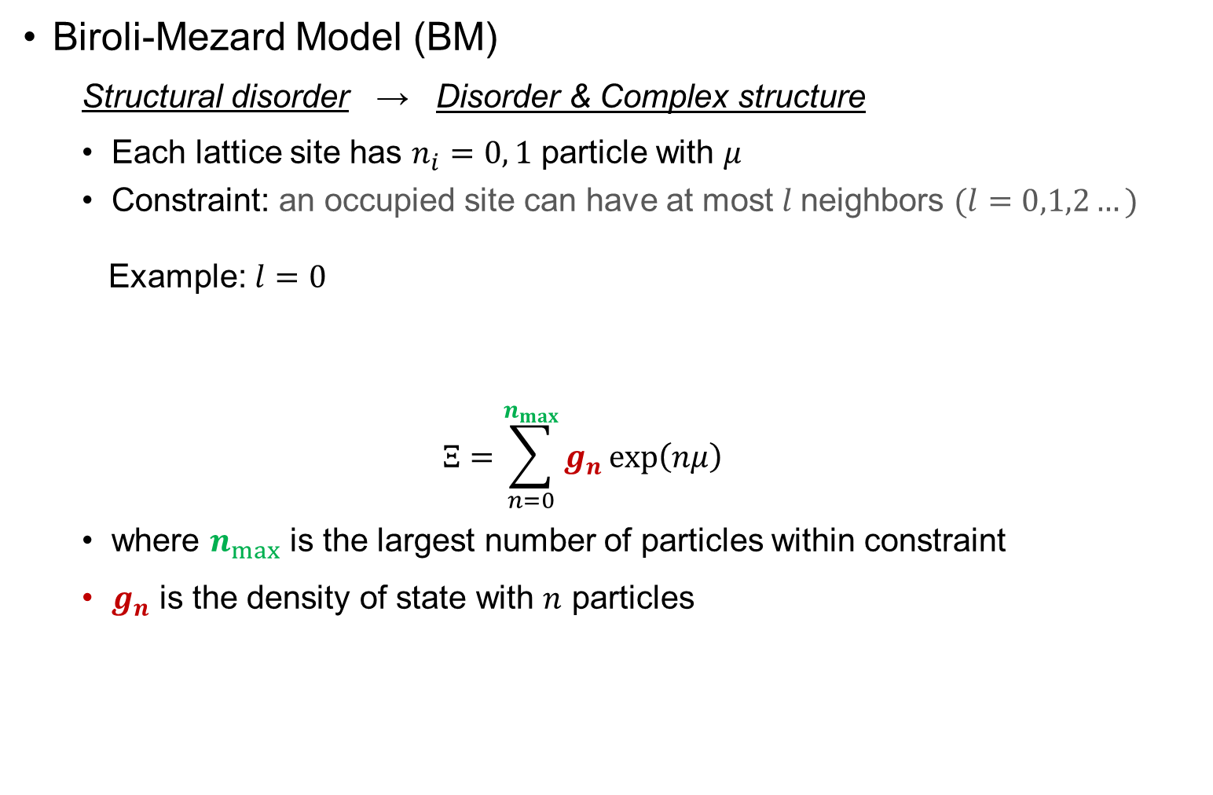
Model: lattice glass model
Biroli-Mezard Model (BM)
Structural disorder → Disorder & Complex structure
Each lattice site has $n_{i}=0, 1$ particle with $μ$
Constraint: an occupied site can have at most $l$neighbors $(l=0,1,2…)$
Example: $l=0$
$$Ξ=\sum_{n=0}^{n_{max}}{g_{n}\exp\left(nμ\right)}$$
where $n_{max}$ is the largest number of particles within constraint
$g_{n}$ is the density of state with $n$ particles
Biroli and Mezard, PRL 88, 2 (2002); Krzakala, Tarzia, and Zdeborova, PRL 101, 165702 (2008)
Notes:
Simple model -> complex and interesting dynamics
Mu -> temperature

Slide 7
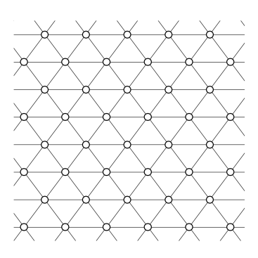
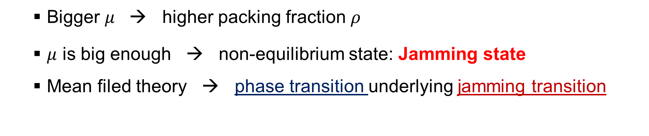

Jamming in lattice glass model
$$μ$$
Bigger $μ$ → higher packing fraction $ρ$
$μ$ is big enough → non-equilibrium state: Jamming state
Mean filed theory → phase transition underlying jamming transition
Biroli and Mezard, PRL 88, 2 (2002); Krzakala, Tarzia, and Zdeborova, PRL 101, 165702 (2008)

Slide 8
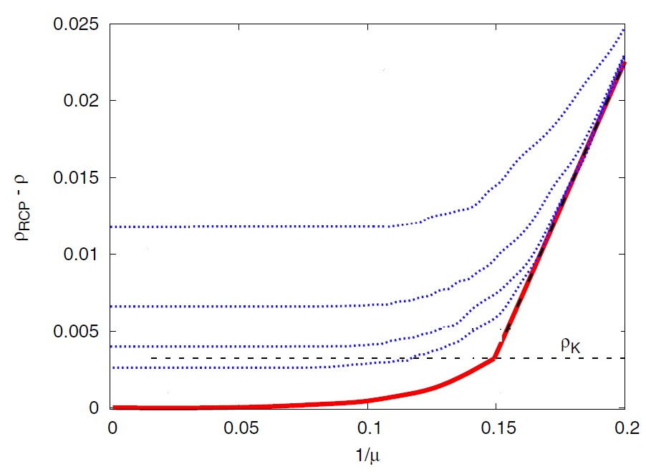
Equilibrium phase transition Jamming Transition?
Mean-field model
Phase transition found underlying jamming transition
True in non-mean-filed model?
Krzakala, Tarzia, and Zdeborova, PRL 101, 165702 (2008)

Slide 9
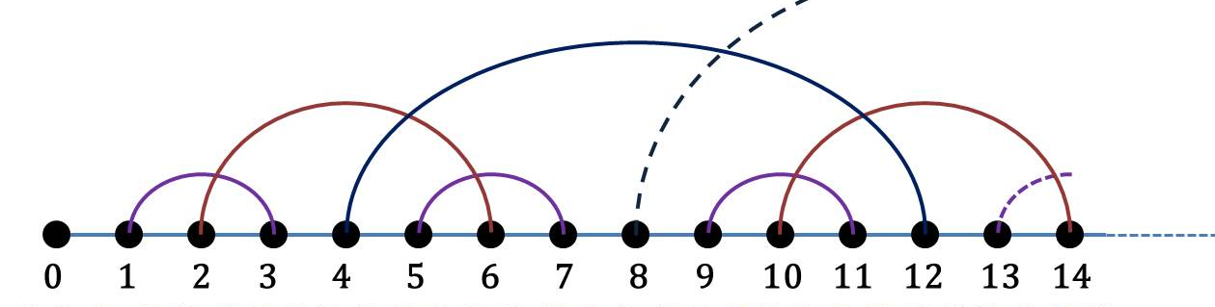

Model: Hierarchical Networks
Hanoi networks (small world network):
fixed structure; analytically solvable
Hanoi Network with degree of 3 (HN3)
Backbone: 1-D: $0$ – $1$ – $2$ – $⋯$ – $N$
Long-range links:
S. Boettcher, B. Goncalves, and H. Guclu, J. Phys. A 41, 252001 (2008)

Slide 10
Model: Hierarchical Networks
Hanoi networks (small world network):
fixed structure; analytically solvable
Hanoi Network with degree of 3 (HN3)
Backbone: 1-D: $0$ – $1$ – $2$ – $⋯$ – $N$
Long-range links:
S. Boettcher, B. Goncalves, and H. Guclu, J. Phys. A 41, 252001 (2008)

Slide 11
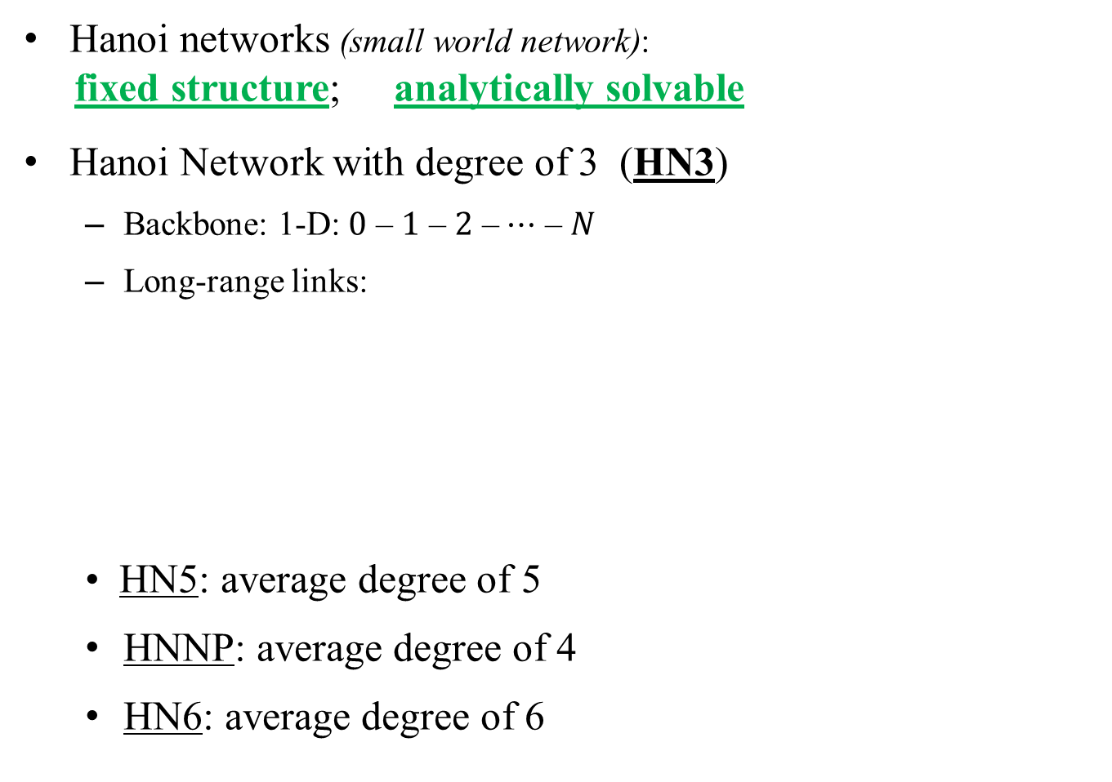
Model: Hierarchical Networks
Hanoi networks (small world network):
fixed structure; analytically solvable
Hanoi Network with degree of 3 (HN3)
Backbone: 1-D: $0$ – $1$ – $2$ – $⋯$ – $N$
Long-range links:
• HN5: average degree of 5
HNNP: average degree of 4
HN6: average degree of 6
S. Boettcher, B. Goncalves, and H. Guclu, J. Phys. A 41, 252001 (2008)

Slide 12
Why Hierarchical Networks (HNs)?
Exactly solvable by Renormalization Group (RG)
Lattice-like structure
Mean-Field HNs Regular lattice
Different structures

Slide 13
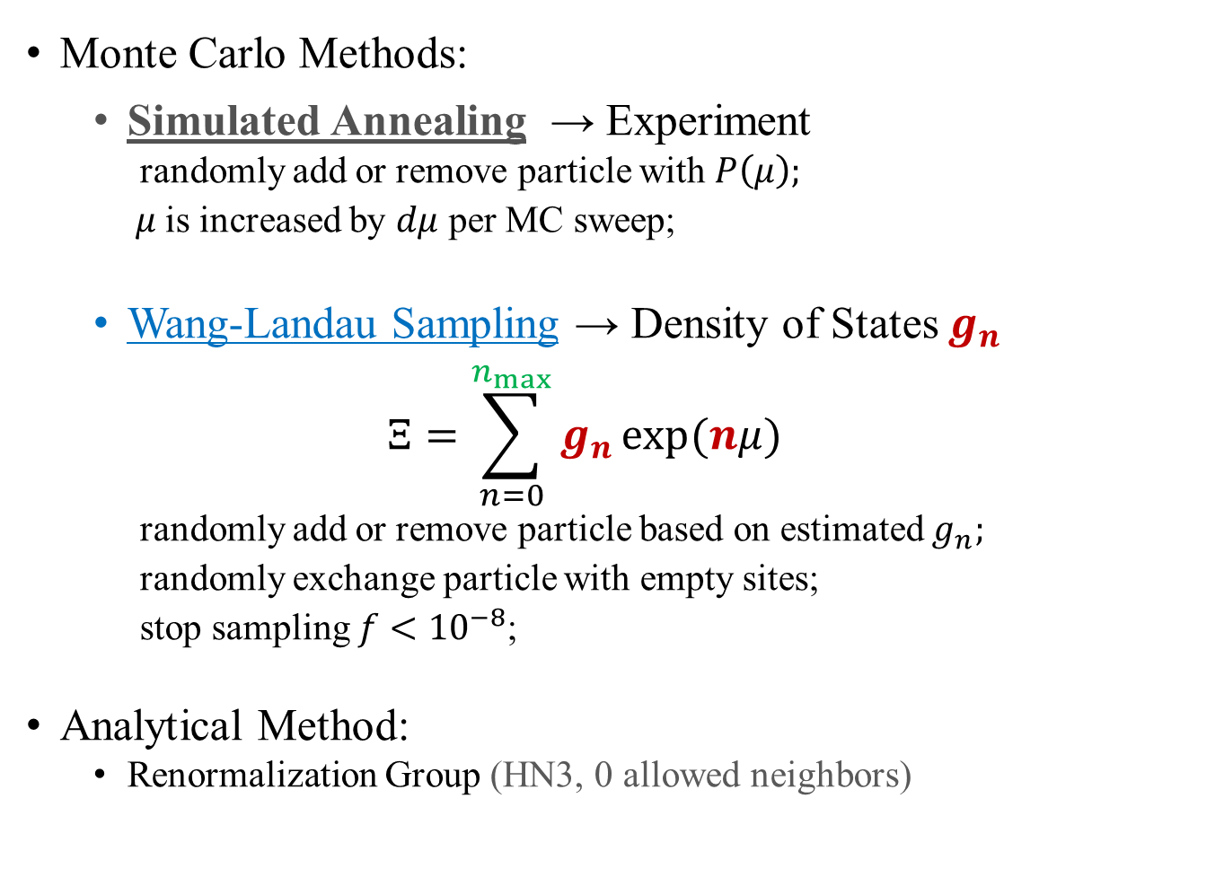
Methods
Monte Carlo Methods:
Simulated Annealing → Experiment
randomly add or remove particle with $P\left(μ\right);$
$μ$is increased by $dμ$ per MC sweep;
Wang-Landau Sampling → Density of States $g_{n}$
$$Ξ=\sum_{n=0}^{n_{max}}{g_{n}}\exp{(nμ)}$$
randomly add or remove particle based on estimated $g_{n};$
randomly exchange particle with empty sites;
stop sampling $f<{10}^{−8}$;
Analytical Method:
Renormalization Group (HN3, 0 allowed neighbors)
Notes:
The probability is Boltzmann equation

Slide 14
Wang-Landau sampling
Histogram method
Non-thermodynamic
Non-Markov-Chain
Analytical Method:
Renormalization Group (HN3, 0 allowed neighbors)
Notes:
Extra slides

Slide 15
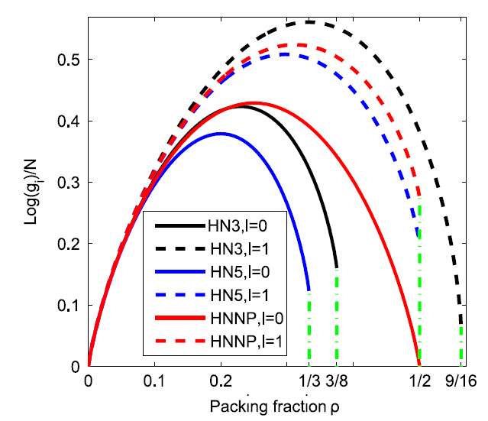
Results of Wang-Landau sampling
N=512
Does NOT converge for larger system size
Notes:
Ground states & Why Wang-Landau fails

Slide 16
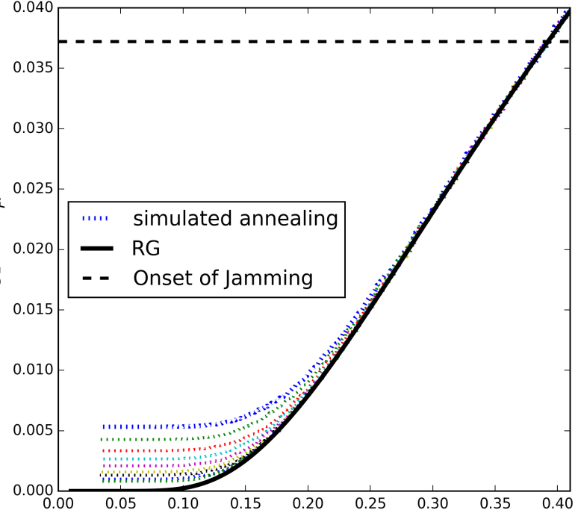


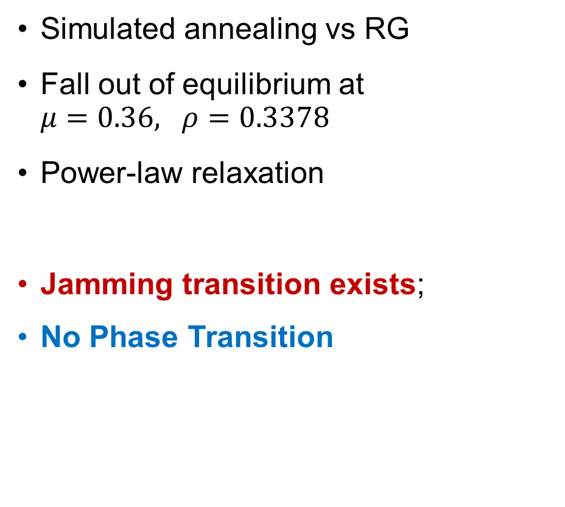


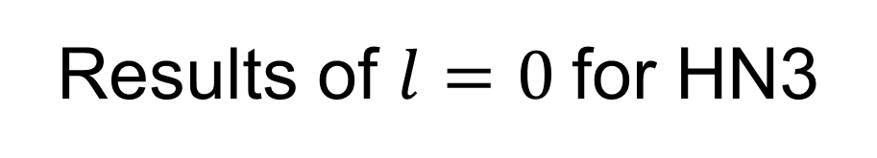

Results of $l=0$for HN3
Simulated annealing vs RG
Fall out of equilibrium at $μ=0.36, ρ=0.3378$
Power-law relaxation
Jamming transition exists;
No Phase Transition
$$ρ_{CP}−ρ_{μ}$$
$$1/μ$$
$$ρ_{CP}−ρ_{∞}$$
$$dμ$$
Notes:
2 sentences on SA not finding the global maximization;

Slide 17
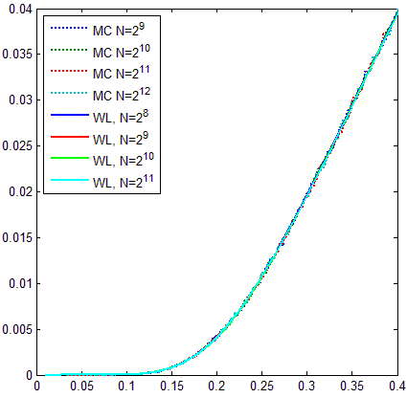
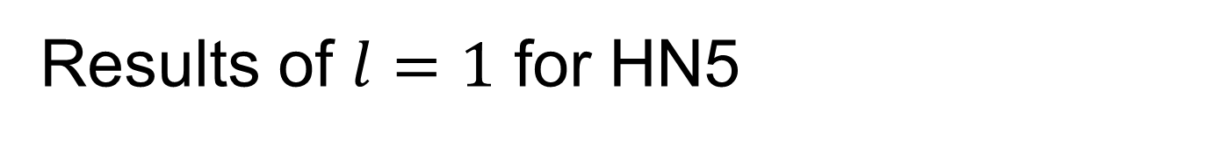


Results of $l=1$ for HN5
Simulation agrees well with Wang-Landau;
Converge faster for large system sizes;
Jamming state DOES NOT exist;
No real phase transition;
$$ρ_{CP}−ρ$$
$$1/μ$$

Slide 18
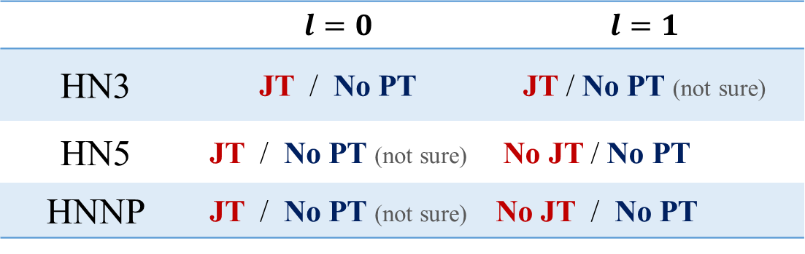
Summary and Conclusion
 | $$l=0$$ | $$l=1$$
HN3 | JT / No PT | JT / No PT (not sure)
HN5 | JT / No PT (not sure) | No JT / No PT
HNNP | JT / No PT (not sure) | No JT / No PT
JT: Jamming Transition; PT: Phase Transition
Glassy dynamics & power-law relaxation & Jamming transition
Jamming transition may not necessarily indicate a real phase transition.
Geometric frustrations may increase computational complexity
Notes:
Computational complexity; carefully

Slide 19
Outline
Introduction of Disordered Systems
Jamming in Hierarchical Networks (HNs)
Antiferromagnetic Ising model in HNs
Aging in Random Field Ising Model
Summary

Slide 20
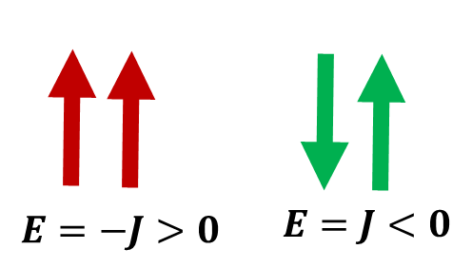
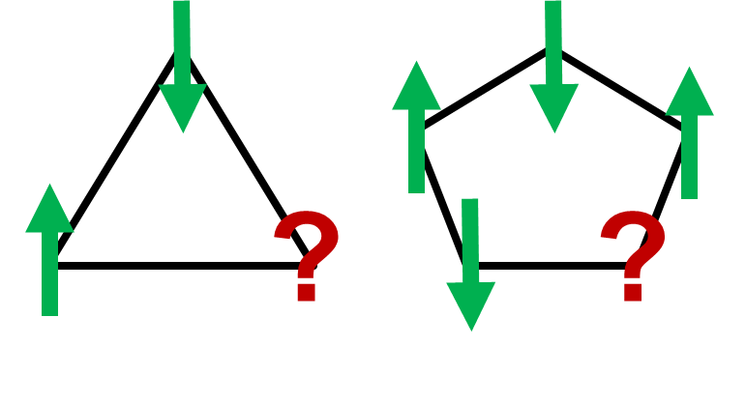
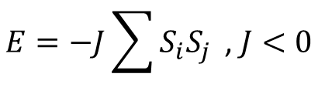
Antiferromagnetic Ising model
Antiferromagnetic Ising model
Geometric frustration: odd loops
$$E=−J\sum{S_{i}S_{j}}\text{ , }J<0$$

Slide 21
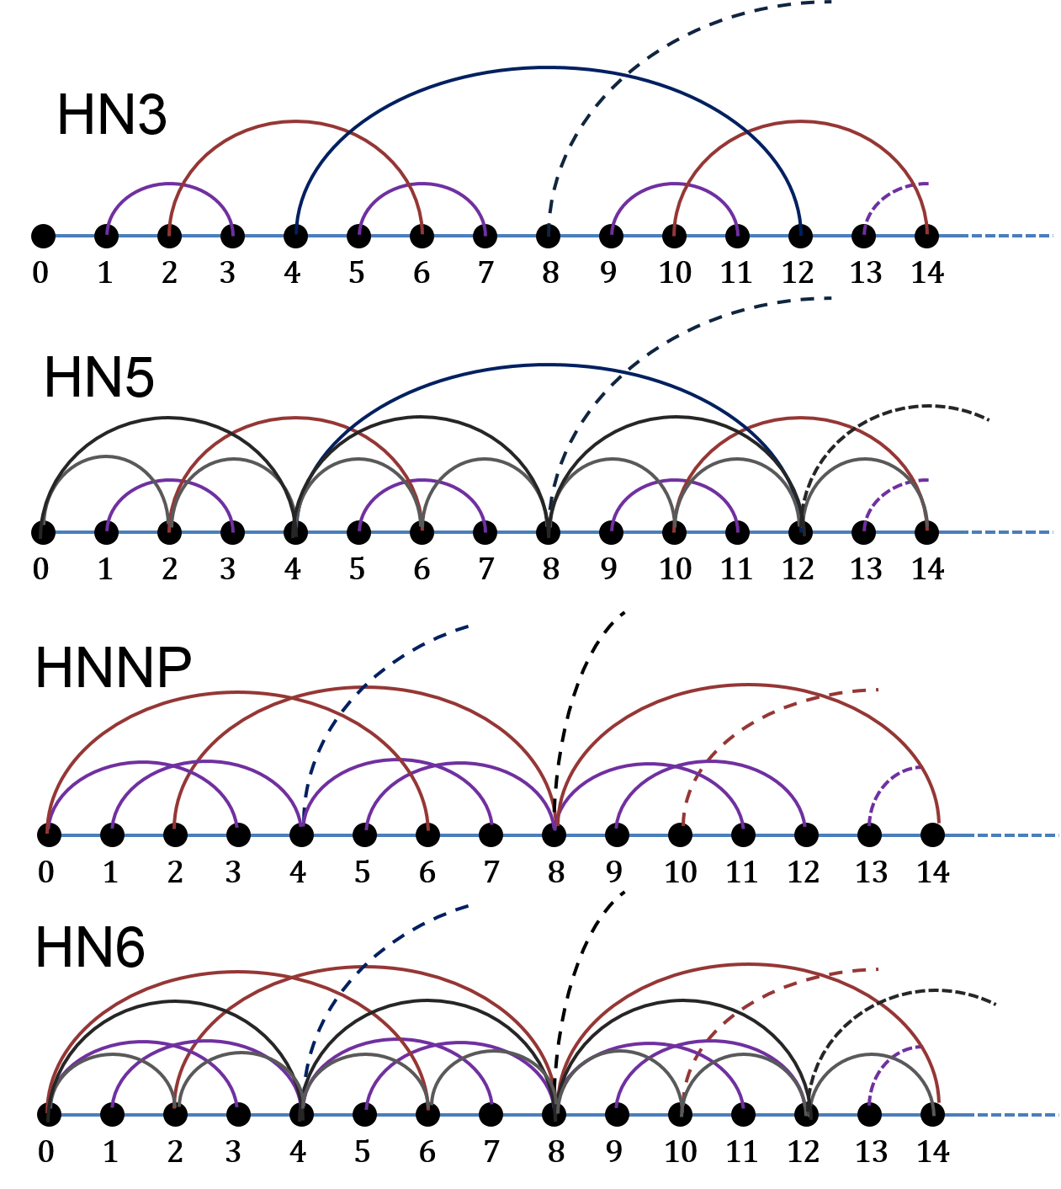

Hierarchical networks (HNs)
HN3
HN5
HNNP
HN6
Interpolations:
Long-range link strength: $y∙J$
$y=0:$ HNNP
$y=1:$ HN6

Slide 22
Research Questions
Glassy dynamics?
Phase transitions?
Equilibrium/non-equilibrium transition?
Spin glass phase?
Influence of geometry?
Difference to mean-field models?

Slide 23
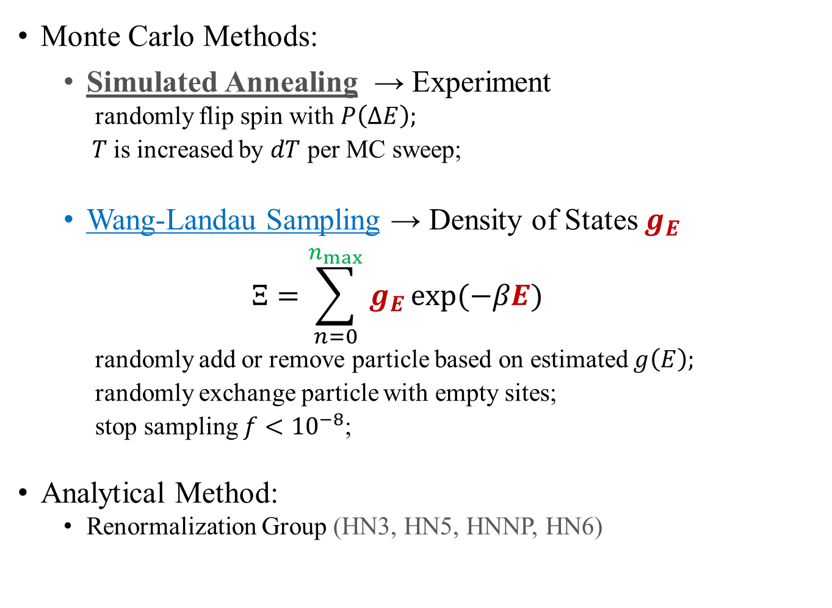
Methods
Monte Carlo Methods:
Simulated Annealing → Experiment
randomly flip spin with $P\left(ΔE\right);$
$T$is increased by $dT$ per MC sweep;
Wang-Landau Sampling → Density of States $g_{E}$
$$Ξ=\sum_{n=0}^{n_{max}}{g_{E}}\exp{(−βE)}$$
randomly add or remove particle based on estimated $g\left(E\right);$
randomly exchange particle with empty sites;
stop sampling $f<{10}^{−8}$;
Analytical Method:
Renormalization Group (HN3, HN5, HNNP, HN6)

Slide 24
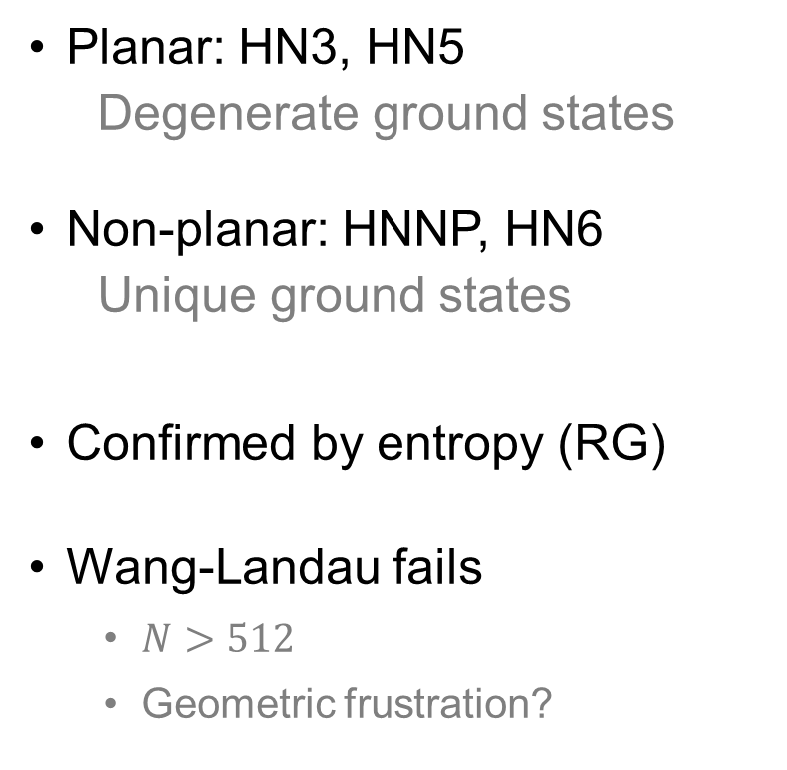
Density of States (WL)
Planar: HN3, HN5
Degenerate ground states
Non-planar: HNNP, HN6
Unique ground states
Confirmed by entropy (RG)
Wang-Landau fails
$N>512$
Geometric frustration?

Slide 25

Glassy relaxation (SA)
$x$ axis: $T$
$y$ axis: $E_{T}−GS$
Extremely slow relaxation at low $T$

Slide 26
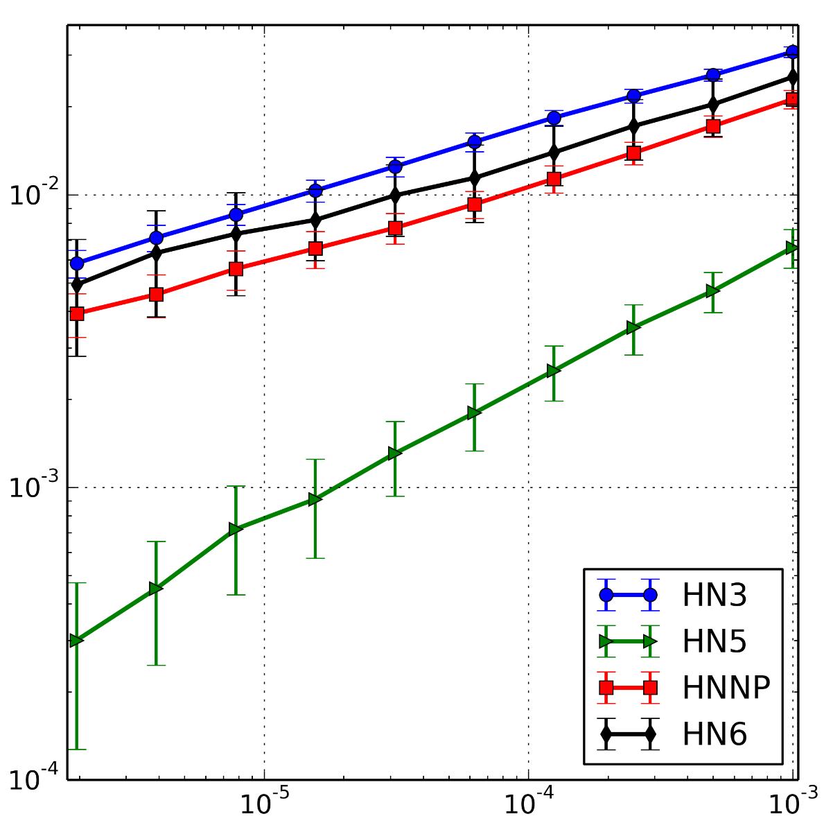
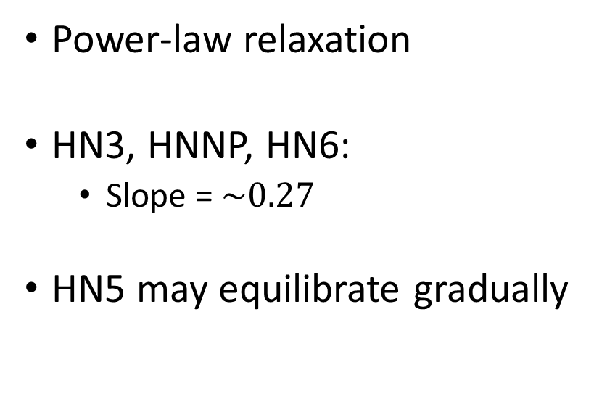

Power-law relaxation (SA)
Power-law relaxation
HN3, HNNP, HN6:
Slope = $\sim 0.27$
HN5 may equilibrate gradually
$$E_{T}−GS$$
$$dT$$

Slide 27
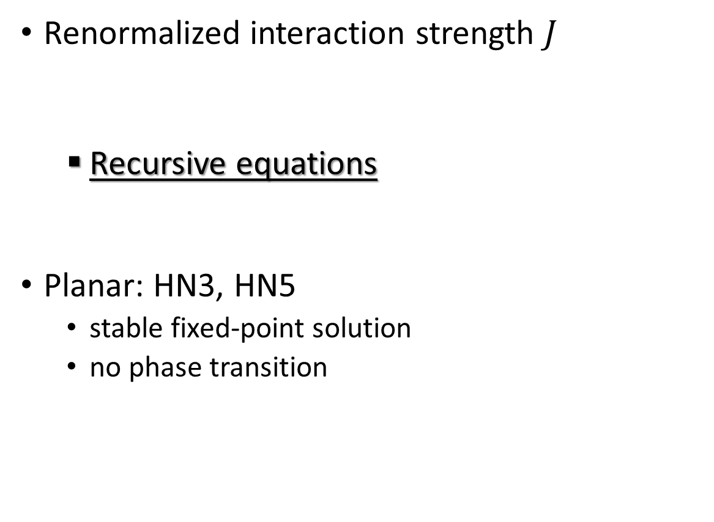
Spin glass transition (RG)
Renormalized interaction strength $J$
Recursive equations
Planar: HN3, HN5
stable fixed-point solution
no phase transition
Numerical solution
Analytical solution
McKay and Berker, Phys. Rev. Lett. 48, 11 (1982)

Slide 28
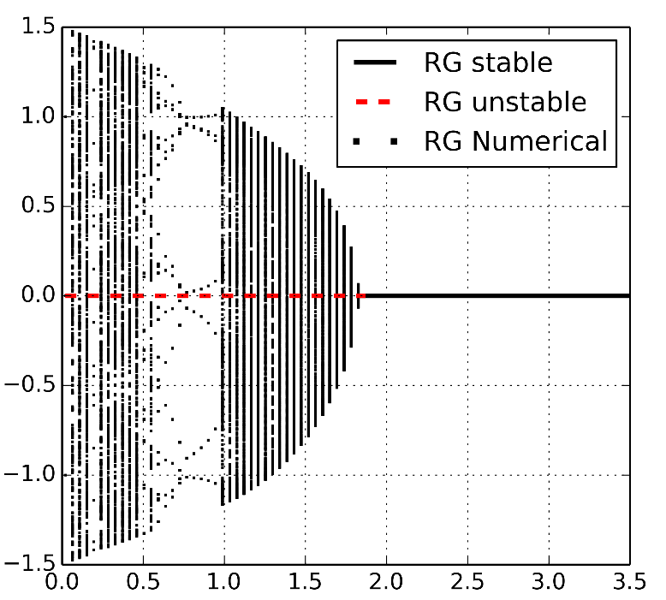

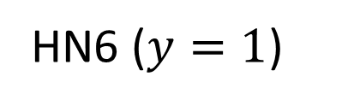
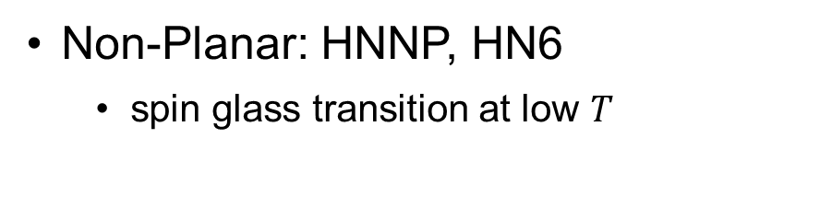
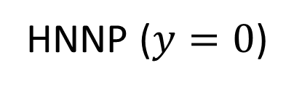


Spin glass transition (RG)
Non-Planar: HNNP, HN6
spin glass transition at low $T$
HNNP ($y=0$)
HN6 ($y=1$)
$$J$$
$$J$$
McKay and Berker, Phys. Rev. Lett. 48, 11 (1982)

Slide 29
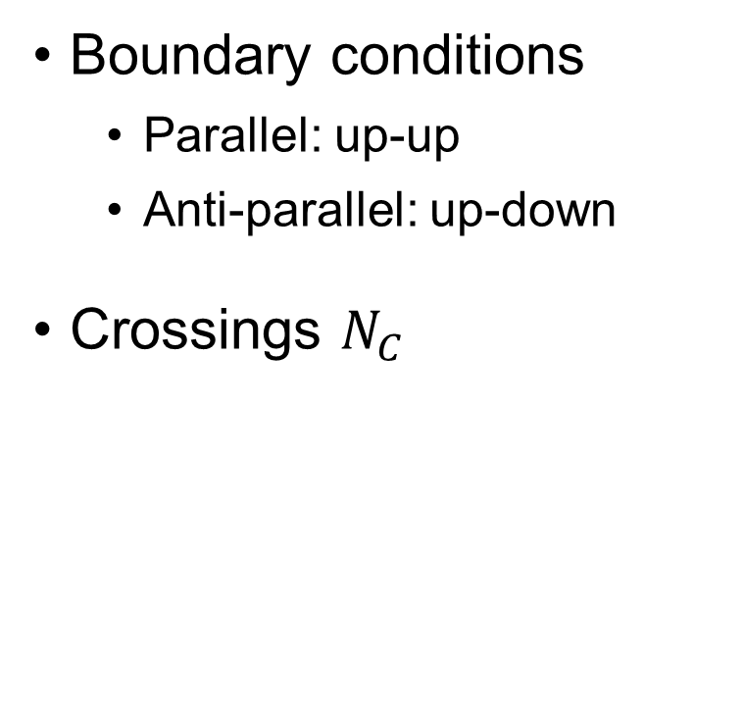
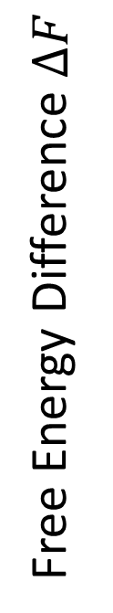
Free energy chaos
Boundary conditions
Parallel: up-up
Anti-parallel: up-down
Crossings $N_{C}$
Free Energy Difference $ΔF$

Slide 30
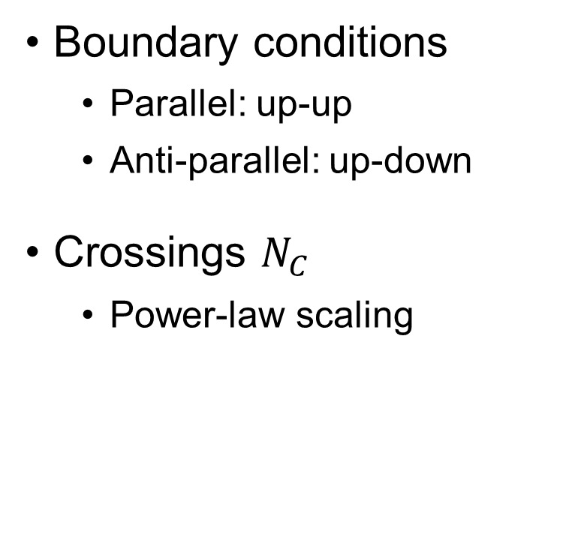
Free energy chaos
Boundary conditions
Parallel: up-up
Anti-parallel: up-down
Crossings $N_{C}$
Power-law scaling

Slide 31

Phase Diagram
Paramagnetic phase
Ferromagnetic
Spin Glass
$$y$$

Slide 32
Summary and Conclusion
Glassy dynamics and power-law relaxation
Free energy chaos in non-planar networks
Spin glass phase transition
Paramagnetic phase
Ferromagnetic
Spin Glass

Slide 33
Outline
Introduction of Disordered Systems
Jamming in Hierarchical Networks (HNs)
Antiferromagnetic Ising model in HNs
Aging in Random Field Ising Model
Summary

Slide 34
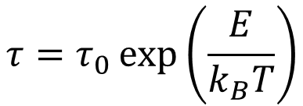
Motivation
Quenched disorder at F-AF interface
H_{ex}
H_{ex}
=
=
Arrhenius activation of magnetic domains*
H_{ex}
H_{ex}
$$τ=τ_{0}\exp\left(\frac{E}{k_{B}T}\right)$$
In the experiment:
Power-law relaxation; small exponent
* E. Fulcomer, S.H. Charap, JAP 1972, and many more thereafter

Slide 35
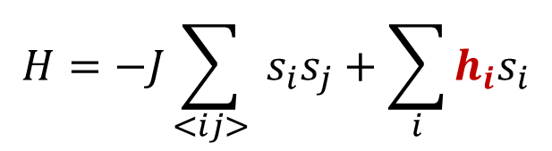
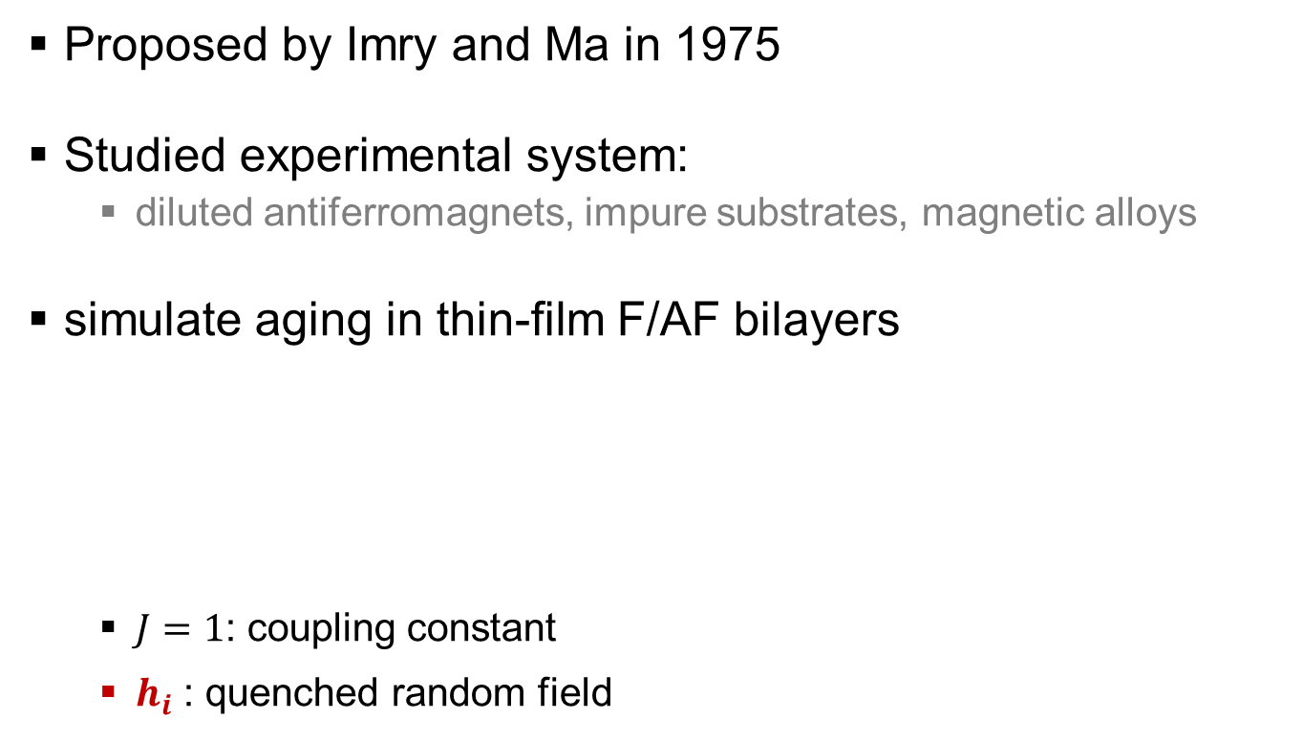
Random Field Ising Model
Proposed by Imry and Ma in 1975
Studied experimental system:
diluted antiferromagnets, impure substrates, magnetic alloys
simulate aging in thin-film F/AF bilayers
$J=1$: coupling constant
$h_{i}$ : quenched random field
$$H=−J\sum_{<ij>}{ s_{i}s_{j}}+\sum_{i}{{h_{i}s}_{i}}$$
Imry and Ma, PRL, 35-21 (1975).

Slide 36
Monte Carlo Simulation
Experiment
1. Thin film
2. Cool down slowly
3. Measure resistance
4. Flip external field
Simulation
1. 2D square lattice
2. Simulated annealing
3. Measure energy
4. Flip random fields
1. Initial State
2. After Annealing

Slide 37
Monte Carlo Simulation

Slide 38

Monte Carlo Simulation
$$\left\langle e\right\rangle =e_{0}+A∙t^{−c}$$

Slide 39
Power-law relaxation

Slide 40
Summary and Conclusion
Simulations agree well with experiments
Power-law relaxation is confirmed
Help understand aging in magnetic systems

Slide 41
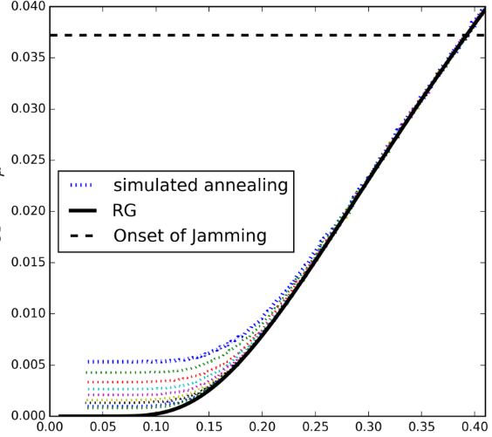

Summary and Conclusion
3 Disordered Systems
Lattice glass model: dynamics- & geometry-induced disorder
Antiferromagnetic Ising model: geometry-induced disorder
Random field Ising model: quenched disorder
Glassy dynamics & power-law relaxation
Equilibrium phase transition is not necessary
Glassy dynamics & chaos indicate computational complexity

Slide 42
Acknowledgement

Slide 43
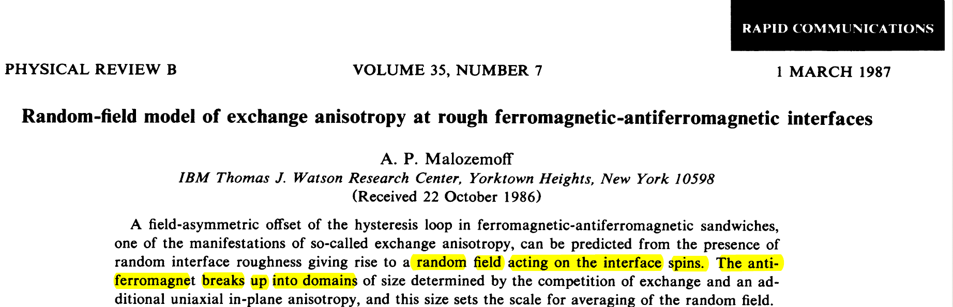
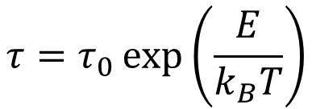
Motivation
Quenched disorder at F-AF interface
Imry-Ma-type domains
H_{ex}
H_{ex}
=
=
Arrhenius activation of magnetic domains*
H_{ex}
H_{ex}
$$τ=τ_{0}\exp\left(\frac{E}{k_{B}T}\right)$$
In the experiment:
Power-law relxation; small exponent
* E. Fulcomer, S.H. Charap, JAP 1972, and many more thereafter

